Slide 1
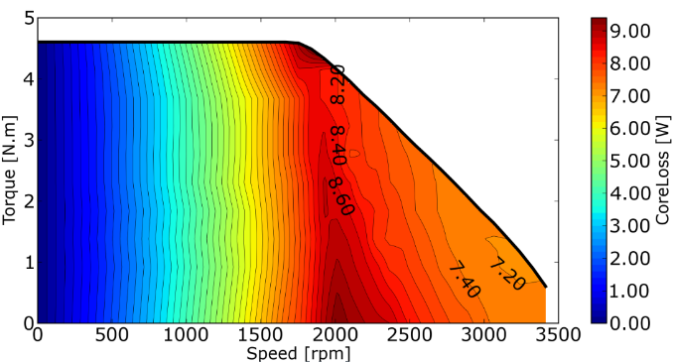
Guidelines for the Preparation of the Poster Session Presentation (Calibri 40pts Bold)
2025 19th Conference on Electrical Machines, Drives and Power Systems ELMA
June 19 - 21 2025, Sofia, Bulgaria
First Author¹, Second Author² and Last Author³ (Calibri 32pts Bold)
¹ First Author Affiliation; ² Second Author Affiliation; ³ Last Author Affiliation (Calibri 26pts)
Abstract
Dear authors, please, use these Guidelines to prepare your poster for the Poster Session of ELMA 2025.
The text size is Times New Roman 26 pts.
The size of the printed poster must be A1 European size or
594 x 841mm.
The author or presenter is responsible for removing the poster after the dialogue session has ended.
…………
The presentation of your poster panel is important. You are recommended to take as much care with it as you did in preparing your written paper.
……………
The author or presenter is responsible for removing the poster after the dialogue session has ended.
…………
The presentation of your poster panel is important.
You are recommended to take as much care with it as you did in preparing your written paper.
You are encouraged to present your research in a visually engaging and informative format that combines scientific accuracy with thoughtful, creative design!
……………
Introduction
The title of the presentation must be the same title as your full paper (with authors and affiliations).
The headlines should be visible from several meters away; so lettering should be large and clear.
………………..
Main results of the work
Display should consist chiefly of keywords, diagrams, photographs etc… Color diagrams and pictures are particularly attractive in a display. Diagrams and graphs should have clear captions. All lettering should be easy to read.
All graphs and diagrams should be drawn with thick lines (preferably 1 mm or more in width). Use different colours to emphasise important features.
…………
Fig. 1 Figure caption with Times New Roman Italic 24pts.
The size of the printed poster must be A1 European size or
594 x 841mm.
Fig. 2 Figure caption with Times New Roman Italic 24pts.
Please do remain strictly in these dimensions. Each poster will be hanged by the presenters using material provided by conference organizers.
Authors have to remain near their poster during the poster session in order to engage a direct discussion with the conference delegates.
………………
Conclusions
Write your conclusions here.
Fig. 3 Figure caption with Times New Roman Italic 24pts.

